Slide 1
Concurrent Programming
CptS 360 Systems Programming
School of Electrical Engineering and Computer Science
Washington State University
Hassan Ghasemzadeh (hassan.ghasemzadeh@wsu.edu)

Slide 2
Topics
Introduction to parallel computing
Parallelism versus concurrency
Introduction to Threads
Thread management functions
Thread example #1 (summation of numbers)
Thread example #2 (summation of matrix elements)
Thread example #3 (quicksort)

Slide 3
Parallel computing
What is parallel computing?
A computing scheme that uses multiple processors executing parallel algorithms to solve problems faster
Why is it possible to achieve higher speed?
Many algorithms use divide and conquer strategy
binary search, quicksort, merge sort, etc.
Such algorithms exhibit a high degree of parallelism
We can exploit this property by using parallel or concurrent executions

Slide 4
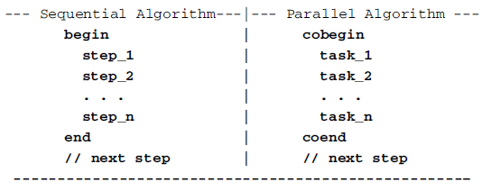
Sequential vs. parallel algorithms
Sequential algorithm
All steps are performed by a single task serially one step at a time
Algorithm ends when all steps have completed
Parallel algorithm
All tasks are performed in parallel
“next step” is performed only after all such tasks have completed

Slide 5
Parallelism vs. concurrency
What does a parallel algorithm specify?
Identiﬁes tasks that can be executed in parallel
It does not specify how to map tasks onto processing elements
What do we need for true parallel executions?
True parallel executions can only be achieved with multiple processing elements (e.g., multiprocessor or multicore systems)
What about single-CPU systems?
A single-CPU system, can execute only one task at a time.
Different tasks can only execute concurrently
Concurrent tasks execute logically in parallel
Concurrency is achieved through multitasking

Slide 6
Parallelism vs. concurrency
Concurrent execution on single-core system:
Parallelism on a multi-core system:

Slide 7
Thread
What is a thread? A basic unit of CPU utilization
Motivation
Most modern applications are multithreaded
Threads run within application
Multiple tasks with application can be implemented by separate threads (e.g., update display, fetch data, spell checking, answer a network request)
Thread model is different than process model
Process model
Processes are independent execution units
Each process executes in a unique address space
A process has only one execution path
When a process must wait for something (e.g., I/O completion), it is suspended, and process execution stops

Slide 8
Thread model
Threads are independent execution units in the same address space of a process
When creating a process, it is created in a unique address space with a main thread
With only a main thread, there is no difference between a process and a thread
The main thread may create other threads
Each thread may create more threads
All threads in a process execute in the same address space of the process
If a thread is suspended, others may continue to execute.

Slide 9
Single and multithreaded processes
A thread comprises a thread ID, a program counter (PC), a register set, and a stack.
It shares with other threads belonging to the same process its code section, data section, and other operating-system resources, such as open files and signals
A traditional process has a single thread of control
If a process has multiple threads of control, it can perform more than one task at a time

Slide 10
Benefits of threads
Responsiveness
may allow continued execution if part of process is blocked, especially important for user interfaces
Resource sharing
threads share resources of process, easier than shared memory or message passing for processes
Economy
cheaper than process creation, thread switching lower overhead than context switching
Scalability
process can take advantage of multiprocessor architectures

Slide 11
Challenges with using threads
Synchronization
Because of shared address space, threads needs explicit synchronization from the user
Many library functions may not be threads safe
Functions that uses global variables or rely on contents of static memory is not threads safe
Considerable efforts are needed to adapt library functions to the thread environment
Speed on single-CPU systems
On these systems using threads is slower than using a sequential program
Overhead of threads creation and context switching

Slide 12


Threads management functions
Pthreads
The threads standard of IEEE POSIX 1003.1c
Pthreads library APIs for threads management
Thread attributes:
e.g., stack parameters; for now, we focus on default attributes.
Cancelling a thread and exiting a thread:
Cancelling is initiated from outside the thread while exiting a thread is done by the thread itself when it determines

Slide 13


Thread creation
pthread_create returns ‘0’ on success and an error number on failure
pthread_id: a pointer to a variable of pthread_t type
ﬁlled with unique thread ID assigned by kernel
In POSIX, pthread_t is an opaque type
Programmer should not know contents of an opaque object because it depends on implementation
A thread may get its own ID by pthread_self() function
pthread_t is deﬁned as unsigned long (thread ID can be printed as %lu)
attr: a pointer to another opaque data type, thread attributes
func: entry address of a function for new thread to execute
arg: pointer to a parameter for thread function, which can be written as

Slide 14
Thread ID
Thread ID is an opaque data type, which depends on implementation
Thread IDs should not be compared directly
If needed, they can be compared by the pthread_equal() function
pthread_equal() returns ‘0’ if threads are different, and non-zero otherwise

Slide 15

Thread termination
A thread terminates when thread function ﬁnishes
Alternatively, a thread may call pthread_exit to terminate
pthread_exit() can be used to terminate thread explicitly
‘status’ is exit status of the thread
A ‘0’ exit value means normal termination, and non-zero values mean abnormal termination.

Slide 16
Thread join
A thread can wait for termination of another thread by
exit status of terminated thread is returned in status_ptr
Examples of pthread_join?
main() thread waits for other threads to finish
In divide and conquer problems, the divided tasks are done by threads and the main() thread combines the results
Many more …

Slide 17
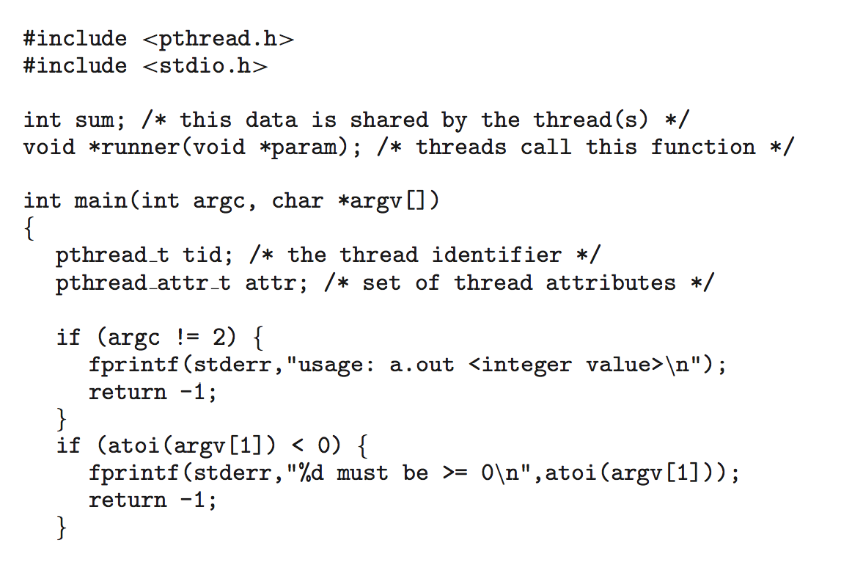
Thread creation example #1
demonstrating Pthreads API for constructing a multithreaded program that calculates summation of a non-negative integer in a separate thread
first, a single thread begins in main()
main() creates a second thread that begins control in runner()
…
both threads share the global data sum

Slide 18
Thread example #1 (cont.)

Slide 19
Thread example #1 (cont.)
Explanation of the code
All Pthreads programs must include the pthread.h header file
Statement pthread_t tid declares id for thread we will create
Each thread has a set of attributes, including stack size and scheduling information. pthread_attr_t attr represents attributes
In this example, we set attributes using pthread_attr_init(&attr)
We did not explicitly set any attributes, we use default attributes
A separate thread is created calling pthread_create()
In addition to passing thread id and attributes, we pass name of function where new thread will begin execution (i.e., runner())
We also pass the integer parameter (using argv[1])

Slide 20
Thread example #1 (cont.)
Explanation of the code
The program has two threads
initial (or parent) thread in main() and the summation (or child) thread performing summation operation in runner()
Program follows thread create/join strategy
After creating summation thread, parent thread waits for it to terminate (pthread_join())
Summation thread terminates when it calls pthread_exit()
Once summation thread has returned, parent thread outputs the value of the shared data sum

Slide 21
How to wait for multiple threads?
The previous example program creates only a single thread
A simple method for waiting on several threads using the pthread_join() function is to enclose the operation within a simple for loop
For example, you can join on ten threads using the Pthread code shown below:

Slide 22

Thread creation example #2
Compute sum of all elements of matrix
Main thread
initializes an N×N matrix
creates N threads, passing a unique row number to each
waits for all the working threads to terminate
When all working threads have ﬁnished, main resumes
computes total sum by adding partial sums generated by threads
Working threads
computes partial sum of a row
deposits partial sum in a row of a global array sum[N]
The C program file (e.g., C4.1.c) can be complied in command line as

Slide 23
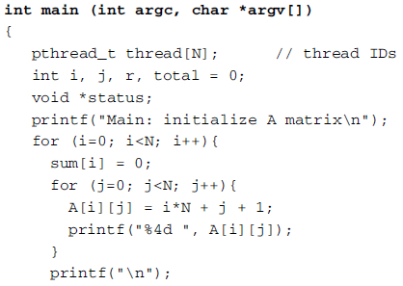
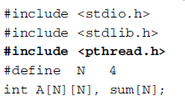
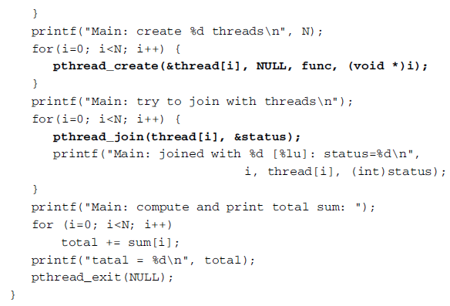
Example #2 (cont.)
Initialize matrix A
Each working thread is called with a different variable ‘i’ value; Use default attributes (NULL passed)
main() waits for threads to finish

Slide 24
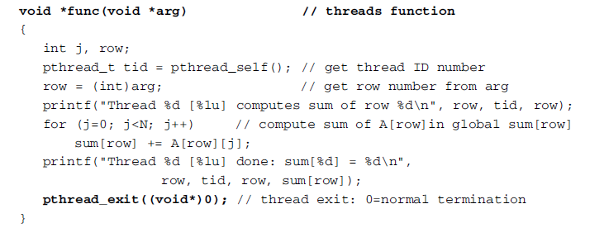
Example #2 (cont.)
The working thread function is shown below

Slide 25
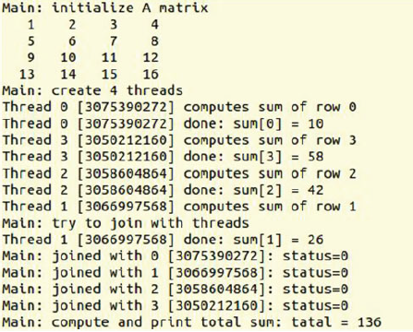
Example #2 (cont.)
A sample output of the program is shown below

Slide 26
Thread creation example #3
Quick Sort
Divide-and-conquer approach to sorting
Partition the array based on elements being less than or greater than some element of the array (the pivot)
i.e., divide phase does all the work; merge phase is trivial.
Fastest generic sorting algorithm in practice
Even faster if use simple sort (e.g., Insertion Sort) when array becomes small
Main idea:
Dividing (partitioning) is non-trivial
Merging is trivial
Let us review Quick Sort algorithm from your data structures class first

Slide 27
QuickSort Algorithm
QuickSort( Array: S)
If size of S is 0 or 1, return
Pivot = Pick an element v in S
Partition S – {v} into two disjoint groups
S1 = {x ∈ (S – {v}) | x < v}
S2 = {x ∈ (S – {v}) | x > v}
Return QuickSort(S1), followed by v, followed by QuickSort(S2)
Q) What’s the best way to pick this element? (arbitrary? Median? etc)

Slide 28
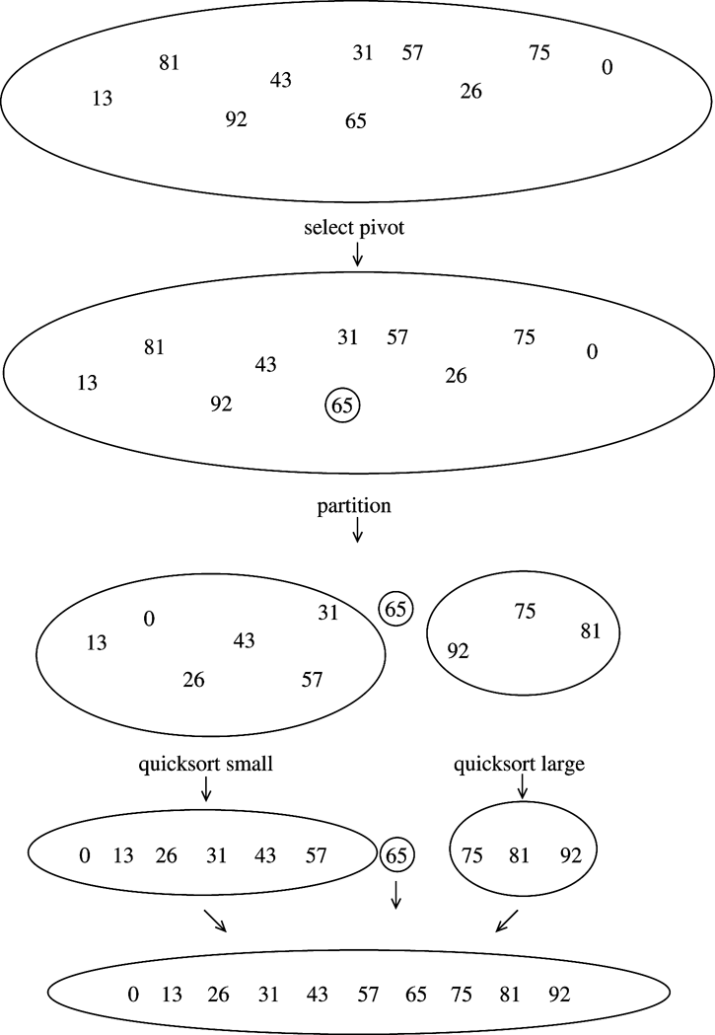
QuickSort Example

Slide 29
Picking the Pivot
Goal: A “good” pivot is one that creates two even sized partitions
Median will be best, but finding median could be as tough as sorting itself
How about choosing the first element?
What if array already or nearly sorted?
Good for a randomly populated array
How about choosing a random element?
Good in practice if “truly random”
Still possible to get some bad choices
Requires execution of random number generator

Slide 30
Picking the Pivot
Best choice of pivot
Median of array
But median is expensive to calculate
Next strategy: Approximate the median
Estimate median as the median of any three elements
Median = median {first, middle, last}
Has been shown to reduce running time (comparisons) by 14%
8 1 4 9 0 3 5 2 7 6
will result in
1 0 3 2 4 8 9 5 7 6
pivot
8 1 4 9 0 3 5 2 7 6
will result in
1 4 0 3 5 2 6 8 9 7

Slide 31
How to write the partitioning code?
6 1 4 9 0 3 5 2 7 8
Goal of partitioning:
i) Move all elements < pivot to the left of pivot
ii) Move all elements > pivot to the right of pivot
Partitioning is conceptually straightforward, but easy to do inefficiently
One bad way:
Do one pass to figure out how many elements should be on either side of pivot
Then create a temp array to copy elements relative to pivot
should result in
1 4 0 3 5 2 6 9 7 8

Slide 32
Partitioning strategy
6 1 4 9 0 3 5 2 7 8
should result in
1 4 0 3 5 2 6 9 7 8
OK to also swap with S[left] but then the rest of the code should change accordingly
This is called “in place” because all operations are done in place of the input array (i.e., without creating temp array)
A good strategy to do partition : do it in place
// Swap pivot with last element S[right]
i = left
j = (right – 1)
While (i < j) {
// advance i until first element > pivot
// decrement j until first element < pivot
// swap A[i] & A[j] (only if i<j)
}
Swap ( pivot , S[i] )

Slide 33
Partitioning Strategy
An in place partitioning algorithm
(1) Swap pivot with last element S[right]
(2) i = left
(3) j = (right – 1)
while (i < j)
(4) { i++; } until S[i] > pivot
(5) { j--; } until S[j] < pivot
(6) If (i < j), then swap( S[i] , S[j] )
(7) Swap ( pivot , S[i] )
Needs a few boundary case handling
Notes:
Examples of boundary cases:
What if i++ results in advancing ‘i‘ all the way to reach pivot (right element)? We can try to prevent this. Similarly for ‘j’ reaching the left side element.
Another case is to compare the first S[i] as well before advancing ‘i‘ because the first S[i] may also be bigger than pivot. Similarly for ‘j’.
These are minor implementation details but are important to ensure correctness of your algorithm in general case.

Slide 34
Partitioning Example
“Median of three” approach to picking the pivot: compares the first, last and middle elements and pick the median of those three → pivot = min{8,6,0} = 6
Swap pivot with last element S[right]
i = left
j = (right – 1)
left
right
8 1 4 9 6 3 5 2 7 0 Initial array
8 1 4 9 0 3 5 2 7 6 Swap pivot; initialize i and j
i j
8 1 4 9 0 3 5 2 7 6 Move i and j inwards until conditions violated
i j
2 1 4 9 0 3 5 8 7 6 After first swap
i j
Positioned to swap
swapped
While (i < j) {
{ i++; } until S[i] > pivot
{ j--; } until S[j] < pivot
If (i < j), then swap( S[i] , S[j] )
}

Slide 35
Partitioning Example (cont.)
After a few steps …
2 1 4 9 0 3 5 8 7 6 Before second swap
i j
2 1 4 5 0 3 9 8 7 6 After second swap
i j
2 1 4 5 0 3 9 8 7 6 i has crossed j
j i
2 1 4 5 0 3 6 8 7 9 After final swap with pivot
i p
Swap (pivot , S[i] )

Slide 36
Handling Duplicates
What happens if all input elements are equal?
Current approach:
{ i++; } until S[i] > pivot
{ j--; } until S[j] < pivot
What will happen?
i will advance all the way to the right end
j will advance all the way to the left end
Thus, pivot will remain in the right position, creating the left partition to contain n-1 elements and empty right partition
Worst case O(n²) performance
Special case: 6 6 6 6 6 6 6 6 6 6 6 6 6 6 6 6
Here, neither i nor j stops; thus, no swaps will be performed => move the pivot to the far right position => creating very uneven subarrays => O(n²) => it takes quadratic time to do nothing!

Slide 37
Handling Duplicates
A better code
Don’t skip elements equal to pivot
{ i++; } until S[i] ≥ pivot
{ j--; } until S[j] ≤ pivot
Here both i and j stop => many swaps between identical elements. But i and j will cross in the middle, so when the pivot is replaced, the partition creates two nearly equal subarrays => O(n log n)
Special case: 6 6 6 6 6 6 6 6 6 6 6 6 6 6 6 6
What will happen now?
Adds some unnecessary swaps
But results in perfect partitioning for array of identical elements
Quicksort is recursive. Suppose n=10,000,000 elements, of which 500,000 are identical. Eventually, quicksort will make the recursive call on only these 500,000 elements. Then it really will be important to make sure that 500,000 identical elements can be sorted efﬁciently.

Slide 38
Thread example #3( cont.)
Parallel quicksort using threads
Similar to previous examples, when the program starts, it runs as main thread of a process
main thread
calls qsort(&arg), with arg=[lowerbound=0, upperbound=N-1]
resumes when all the subthreads have ﬁnished, the main thread resumes.
prints the sorted array and terminates
qsort() thread
implements quicksort of an array of N integers
picks a pivot to divide the array into two parts
creates two subthreads to sort each of the two parts
waits for the subthreads to ﬁnish

Slide 39
Then it creates two subthreads to sort each of the two parts, and waits for the subthreads to ﬁnish. Each subthread sorts its own range by the same algorithm recursively. When all the subthreads have ﬁnished, the main thread resumes. It prints the sorted array and terminates. As is well known, the number of sorting steps of quicksort depends on the order of the unsorted data, which affects the number of threads needed in the qsort program.

Slide 40
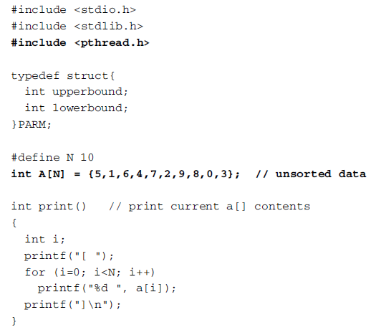
Thread example #3 (cont.)
The code for parallel quick sort

Slide 41
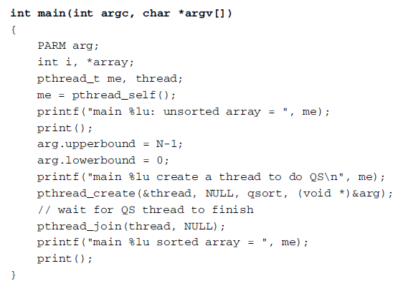
Thread example #3 (cont.)
The code for parallel quick sort

Slide 42
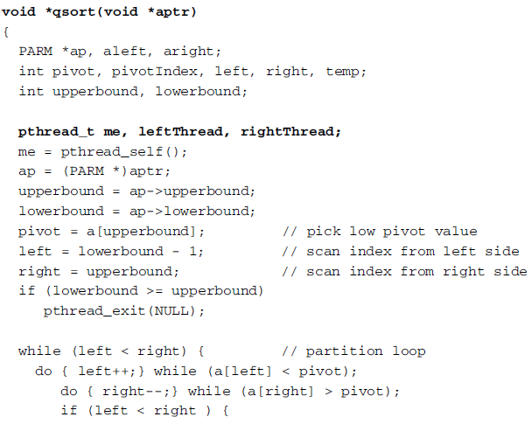
Thread example #3 (cont.)
pointer to a structure that maintains left and right index
all threads will call the same qsort function with different upperbound and lowerbound index
partition part of the algorithm

Slide 43
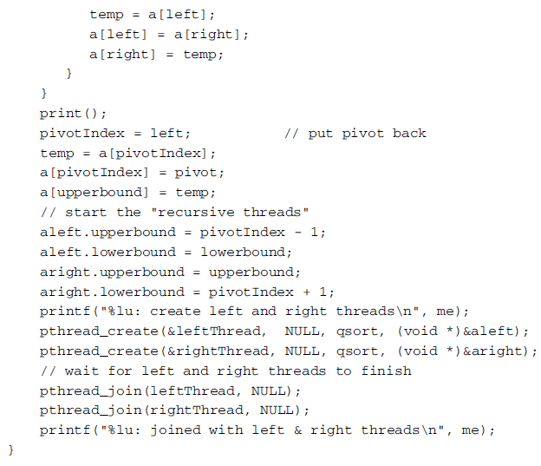
Thread example #3 (cont.)

Slide 44
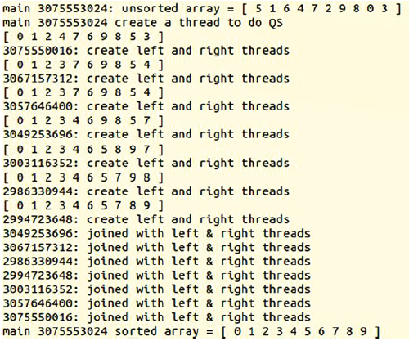
Thread example #3 (cont.)
Sample output of the program

